Slide 1
CS3003: Lecture 10
What are we doing here, really?

Slide 2
Learning Objectives
By the end of class today, you will be able to
define syntax, semantics, language, grammar (non)terminal symbols, start symbol, sentential form, derivation, and parse tree;
draw a derivation;
correct a grammar;
draw a parse tree; and
more?

Slide 3
Syntax and Semantics
A long time ago, in a galaxy far, far away …
Semantics?
Syntax?
Notes:
Semantics: 8/23; Syntax: 8/23

Slide 4
Syntax and Semantics (2)
Syntax (alternate definition): The syntax of a programming language specifies the form of its expressions, statements and program units.
Semantics (alternate definition): The semantics of a programming language specifies the meaning of its expressions, statements and program units.
Notes:
Semantics: 8/23; Syntax: 8/23

Slide 5
What is the name of this course?
Programming Languages
But what about this?
Done plenty of this.

Slide 6
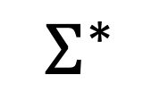
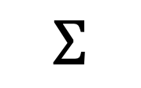
Language
If we are going to write a language, what do we need?
$$Σ$$
A finite set of characters.
$$Σ^{∗}$$
Alphabet
The set of all strings composed of characters from the alphabet.

Slide 7
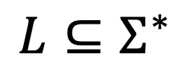
Monkeys Banging a Keyboard
$${L⊆Σ}^{∗}$$
$$Σ^{∗}$$
L

Slide 8
How do we specify L?
Can we just list all strings in L?

Slide 9
Good, Better, Betterer, …
Context Sensitive
Context Free
Regular

Slide 10
Context-Free Language Spec
We can use a grammar: A (context-free) grammar has a set of productions P, a set of terminal symbols, T, a set of non-terminal symbols, N, one of which is named S and is known as the start symbol.

Slide 11

Grammar of Integers
$$Integer →Digit | Integer Digit$$
$$Digit→$$
0 | 1 | 2 | 3 | 4 | 5 | 6 | 7 | 8 | 9
Productions

Slide 12
Grammar of Integers
$$Integer →Digit | Integer Digit$$
$$Digit→$$
0 | 1 | 2 | 3 | 4 | 5 | 6 | 7 | 8 | 9
Start Symbol

Slide 13
Grammar of Integers
$$Integer →Digit | Integer Digit$$
$$Digit→$$
0 | 1 | 2 | 3 | 4 | 5 | 6 | 7 | 8 | 9
Non terminals

Slide 14
Grammar of Integers
$$Integer →Digit | Integer Digit$$
$$Digit→$$
0 | 1 | 2 | 3 | 4 | 5 | 6 | 7 | 8 | 9
Terminals

Slide 15
Grammar of Integers
$$Integer →Digit | Integer Digit$$
$$Digit→$$
0 | 1 | 2 | 3 | 4 | 5 | 6 | 7 | 8 | 9
Alternatives

Slide 16
Derivation

Slide 17
Derivation

Slide 18
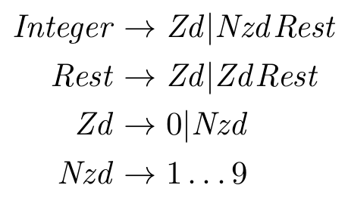
A better Integer Grammar

Slide 19
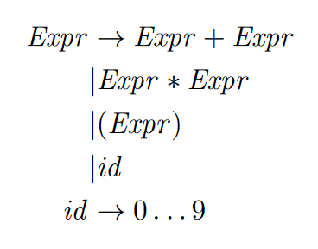
Express Yourself

Slide 20
Derivation

Slide 21
Derivation

Slide 22
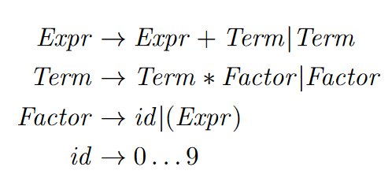
Express Yourself Clearly

Slide 23
Derivation

Slide 24
Static Semantics
Additional restrictions on legal programs that can be calculated statically (i.e., by the compiler).

Slide 25
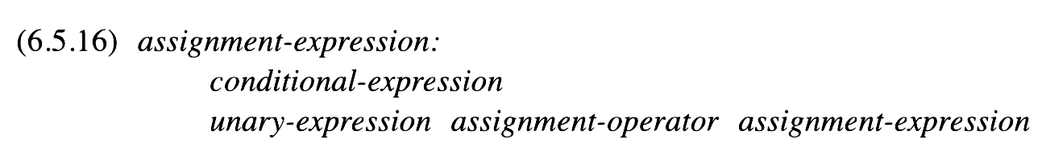
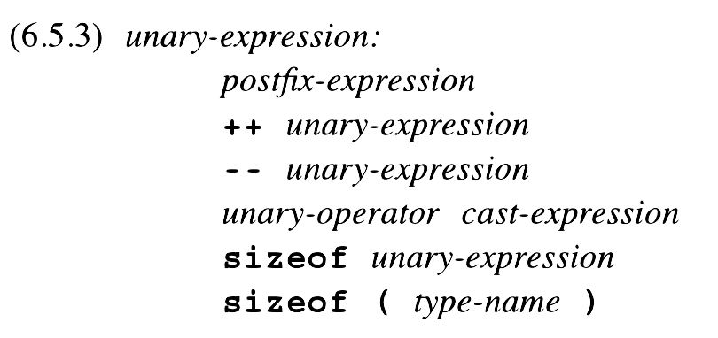
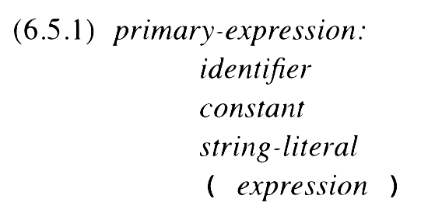
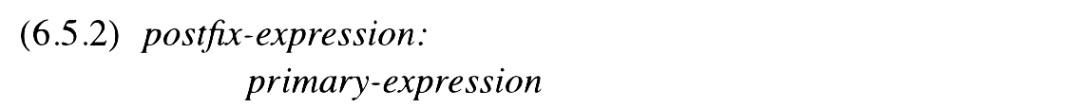
Are You For Real?

Slide 26
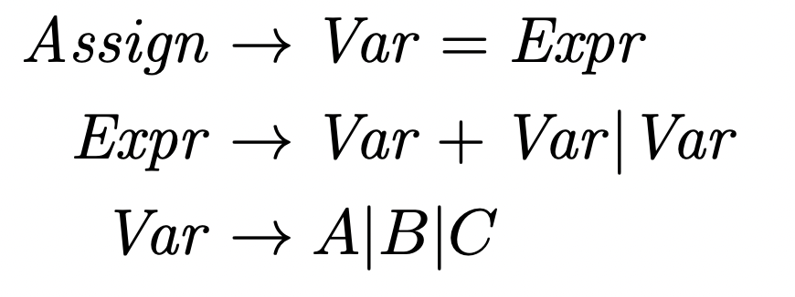
Assignment
What can’t this capture?

Slide 27
Derivation

Slide 28
Static Semantics Using Attribute Grammars
Attribute Grammar: An extension of a CFG that adds (semantic) information to its productions.
Attributes:
Inherited: Attribute calculated using peer or parent nodes.
Synthesized: Attribute calculated using only child nodes.
Intrinsic: Attribute calculated from outside the parse tree.
Predicates: Boolean-valued functions that determine whether a derivation can proceed.

Slide 29

Attributes and Predicates
V
E
Attributes:
E.x = V.a

Slide 30

Attributes and Predicates
E
V₁
V₂
V₃
Attributes:
if (V₁.a == V₂.a && V₁.a == int)
E.a = int
else
E.a = real
E.a = V₃.a
Predicate:
E.a == E.x

Slide 31

Attributes and Predicates
V
Attributes:
V.a = lookup(A | B | C)

Slide 32
Attributes and Predicates
An assignment must be done to a variable with matching type.
A variable has a type declared from earlier code (and it is stored in the symbol table).
Two variables added together have
The variables’ types (when they match)
Real (when they do not)

Slide 33
Attributes and Predicates
Expected Type: The type that is expected for the expression. Inherited. (Abbreviated x)
Actual Type: The actual type of the expression. Synthesized. (Abbreviated a)
Predicate: In certain cases, these must match!

Slide 34
Derivation

